Slide 1
Checking and securing dividing a fraction by a whole number
Task A: Contexts for dividing fractions
1) A pizza is split into 12 equal pieces. A teacher takes 2 pieces and the remaining is given equally between 2 students. What fraction of the whole pizza does each student receive?
2) There are 14 crayons in a box. Two are lost and the rest are shared equally between a table of 4 students. What fraction of the full crayon box does each student receive?
3) A chocolate bar has 24 equal pieces. The teacher eats 6 pieces and shares the rest between 3 students. The teacher says, everyone has had the same fraction of the chocolate bar. Is the teacher correct?
4) A pizza is cut into 4 equal pieces. There are 6 people who need to share the pizza equally. How should the pizza be cut so everyone receives an equal piece? What fraction does each person receive?
Task B: Dividing any fraction by a whole number
1) Match the questions and answers.

Slide 2

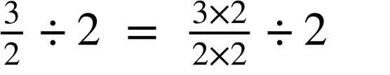
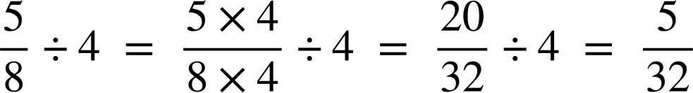
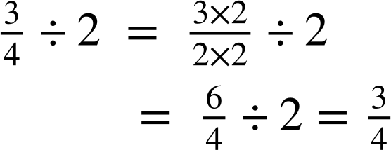
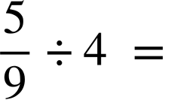
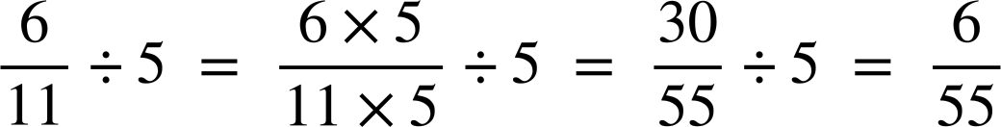
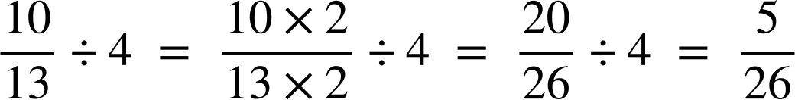
Checking and securing dividing a fraction by a whole number
2) Work out the answers to the following. You can draw bar models if needed.
a)
b)
c)
d)
3) Jacob has used equivalent fractions to work out his answer but has spilt ink all over his work. Can you identify what his missing numbers were?
a)
b)
4) Work out the answers to the following, giving your answer in its simplest form.
a)
b)
c)
Mathematics in Education and Industry.

